Slide 1
TUT01 – Get familiar with the programming environment COMP1411: Introduction to Computer Systems
Dr. Mingsong LYU
Department of Computing
The Hong Kong Polytechnic University
Spring 2023
These slides are only intended to use internally. Do not publish it anywhere without permission.

Slide 2
Objectives
To get familiar with C programming with gcc
Learn to login the COMP Apollo server with SSH clients
Learn to upload files to Apollo with FTP clients
Learn to compile a C program with gcc
Review of LEC01: to get the first impression on compiling process and data types
Try to decompile the “hello” program by yourself with objdump
Revisit some problems in the lecture

Slide 3
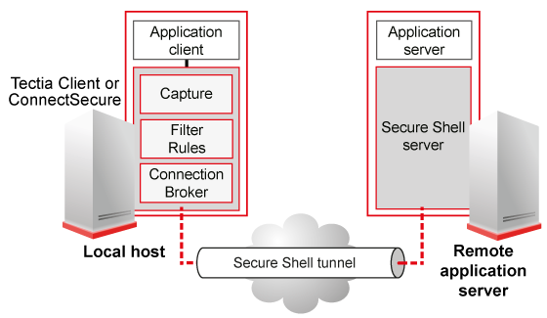
Remote login Apollo
Login a remote server
Apollo is a server machine with a CentOS Linux operating system installed
The operating system allows remote access with the SSH protocol
More on SSH: https://en.wikipedia.org/wiki/SSH_(Secure_Shell)
Usually, we use a client software, e.g., PuTTY, to remotely access a server
Remote server login will be very common for programming exercises in this online learning period
PuTTY
gcc, gdb, etc.
Your Computer
Apollo

Slide 4
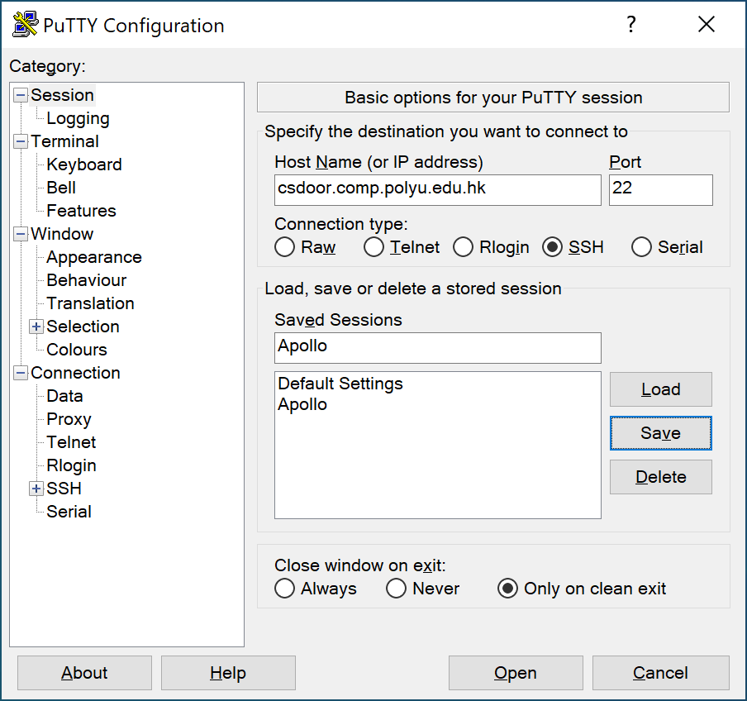
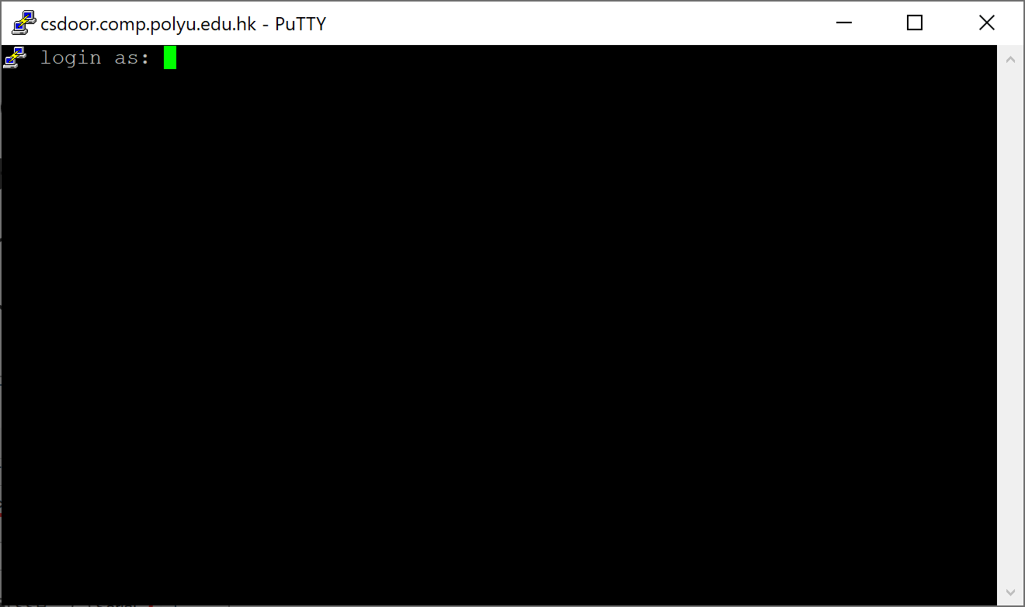
Remote login Apollo
Open PuTTY and connect
Host Name: csdoor.comp.polyu.edu.hk Port: 22
Connection Type: SSH
Remember to save the session to avoid input again next time
Input a name in the “Saved Sessions” field, and click “save”

Slide 5
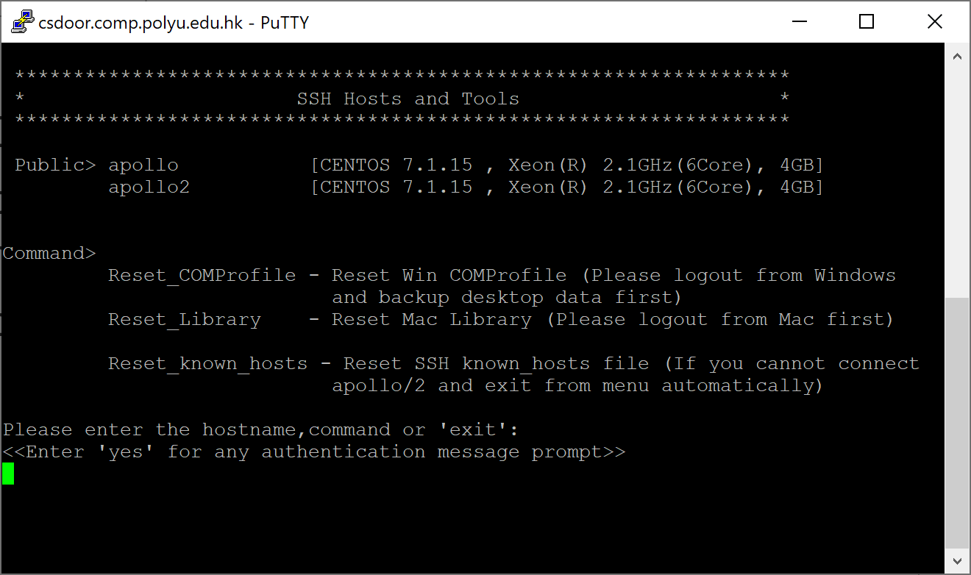
Remote login Apollo
Login with COMP ID
Input COMP ID -> input COMP password
Note that when entering password, nothing is shown on the screen, keep typing and make sure to input the correct password
Once successful, you will come to the host selection step
Input “apollo” and press ENTER to select the first server

Slide 6
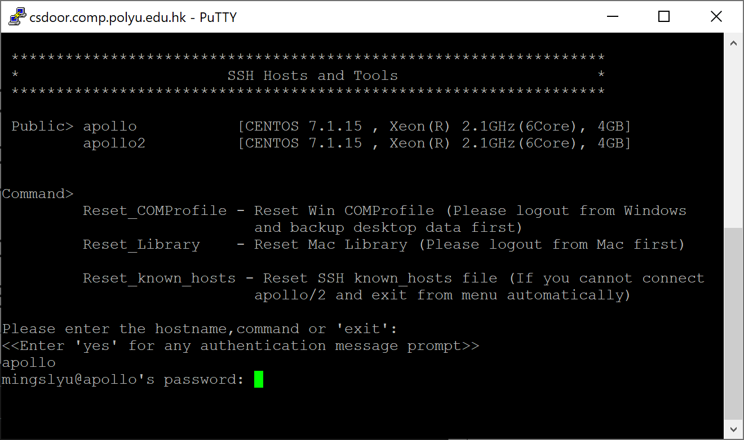
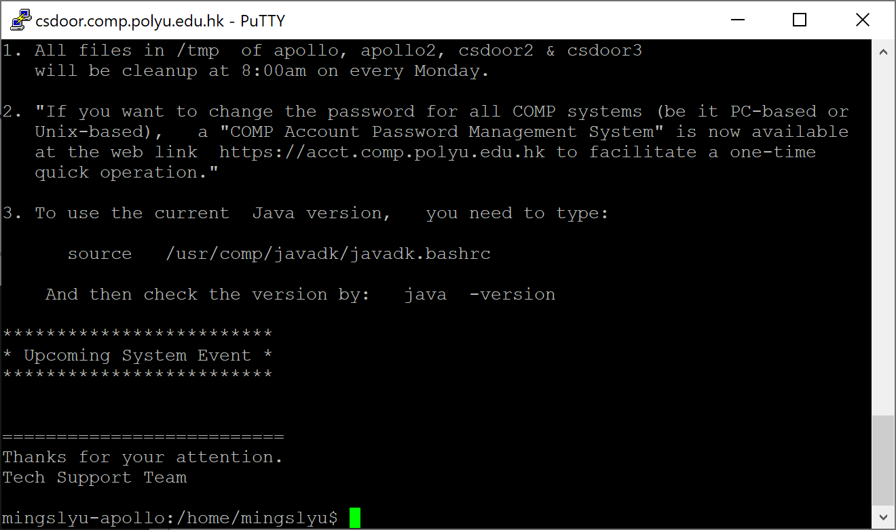
Remote login Apollo
Login with COMP ID
Input your password again, and you are done!

Slide 7
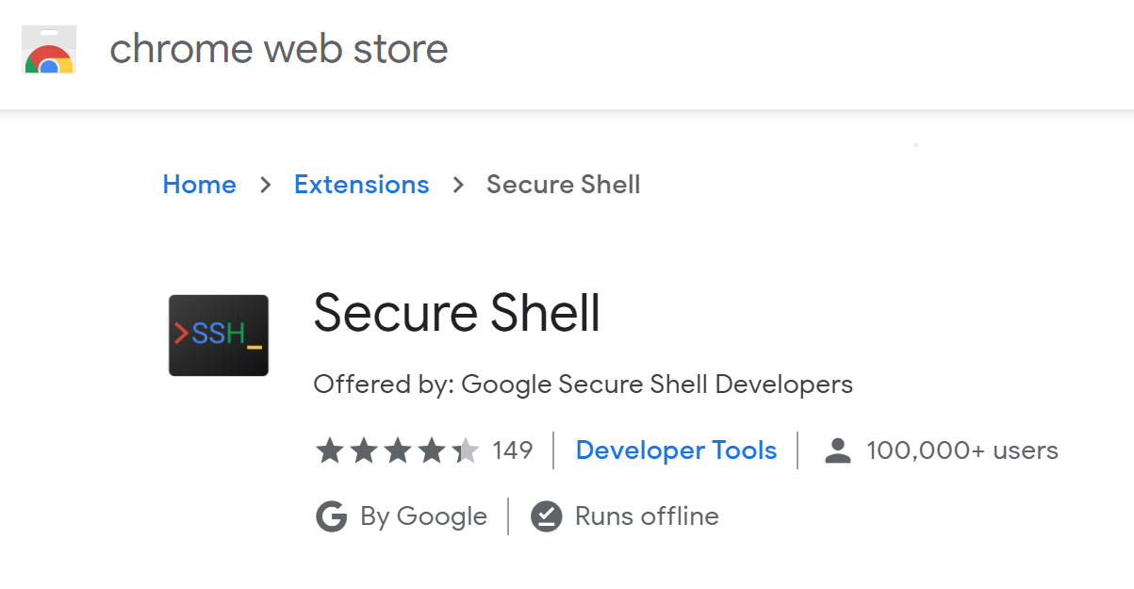
Remote login Apollo
For Windows
Option 1: Use the PuTTY client software
https://www.putty.org/
Option 2: Use command prompt
Open “cmd”, and input command
ssh –l uid csdoor.comp.polyu.edu.hk
(replace uid with your COMP ID)
Option 3: Use “Chrome explorer + Secure Shell extension”
Install Chrome, add the “secure shell extension”
For Mac OS
Option 1: PuTTY for MacOS is not provided, but you can search online for other SSH client software
Option 2 and 3 for Windows also apply for Mac OS
Option 2: launchpad, search for “terminal”
We will use PuTTY on Windows for demonstration in our tutorials

Slide 8
Upload files to Apollo
Upload files
Usually, we use the FTP protocol to transfer files between your own computer and a remote server
For simple operation, we typically use a FTP client
We use FileZilla for both Windows and Mac OS
https://filezilla-project.org
Of course, any other FTP clients also get the work done

Slide 9
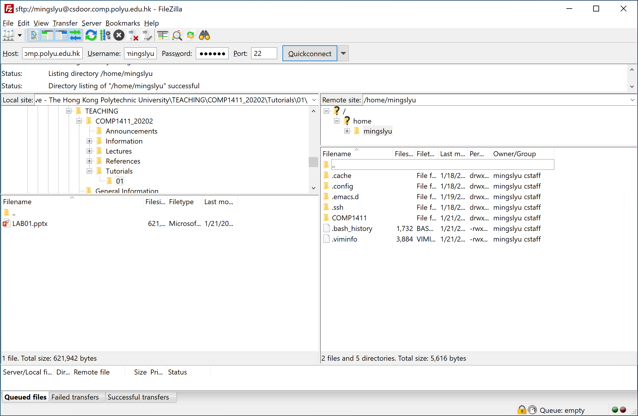
Upload files to Apollo
Open FileZilla, and input connection information
Host: csdoor.comp.polyu.edu.hk; Username: your COMP ID
Password: your COMP password; Port: 22
Then click “Quickconnect”, and your connection will be remembered by the software so that you don’t have to input again next time

Slide 10
Upload files to Apollo
File management on the server and file transfer between your computer and the server, with drag and drop, right click, etc.
Make a new directory “COMP1411” and put everything of this course here, to avoid mix-up with other courses
Navigate the file system on your own computer
Navigate the file system on the remote server
drag & drop

Slide 11
Compile and Decompile “hello”
OBJECTIVE: to learn how to compile a program and get the very first impression on the compilation process
Create a new directory “TUT01” under the “comp1411” directory
Copy the hello.c file to “TUT01” with FileZilla
Compile and run the program
gcc -v
gcc hello.c –o hello
./hello
Compile the program again with intermediate files, and decompile
gcc –save-temps hello.c –o hello
objdump –D hello.o > hello-obj-dump.txt
objdump –D hello > hello-exe-dump.txt
Transfer all newly generated files back to your own computer, and view the files with any text editor on your computer

Slide 12
Revisit the “X² < 0” problem
OBJECTIVE: to get the very first impression on data types
I will explain the reason for the “X² < 0” phenomenon
Copy the file “intsquare.c” to directory “TUT01”
Compile and run the program
gcc –std=c99 intsquare.c –o int
./int
Even though, for now, you still cannot precisely explain why, remember what you’ve done and seen, and let’s make it clear in LEC02

Slide 13
Revisit the “(x+y)+z ≠ x+(y+z)” problem
OBJECTIVE: to get the very first impression on data types
I will explain the reason for the problem
Copy the file “addition.c” to directory “TUT01”
Compile and run the program
gcc addition.c –o add
./add
What do you see? Remember it, and let’s make it clear in LEC03

Slide 14
More on the programming environment
If you think editing and compiling a program is too inconvenient remotely on Apollo, there are other options
Installing a gcc compiling environment on Windows/Mac OS
MinGW-64 for Windows: https://sourceforge.net/projects/mingw-w64
HomeBrew for Mac OS: https://brew.sh/
Install a Linux on a virtual machine or on a bare-metal
Linux operating system family has the best support for gcc-based development environment
Virtual machine solution: VirtualBox + Ubuntu Linux

